Slide 1

Project 1: Corona Virus Analysis

Slide 2
Understanding the Spread and Impact of the Corona Virus
Data analysis is crucial for understanding the global spread and impact of the Corona Virus pandemic. Purposeful gestures
The primary goal is to derive actionable insights from Corona Virus dataset to aid decision-making for prevention and response efforts
The dataset includes geographic subdivisions, entities, coordinates, dates, and counts of confirmed cases, deaths, and recoveries.
Analysis involves techniques such as exploratory data analysis, temporal analysis, statistics, and visualization.
The expected outcome is clear and actionable insights to assist stakeholders in mitigating the spread and impact of the Corona Virus.

Slide 3
Dataset Description
Province: Geographic subdivision within a country/region.
Country/Region: Geographic entity where data is recorded.
Latitude: North-south position on Earth's surface.
Longitude: East-west position on Earth's surface.
Date: Recorded date of Corona Virus data.
Confirmed: Number of diagnosed Corona Virus cases.
Deaths: Number of Corona Virus related deaths.
Recovered: Number of recovered Corona Virus cases.

Slide 4
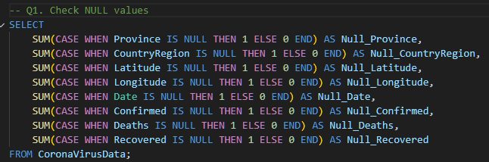
Q1. Check NULL values

Slide 5


Q2. Check total number of rows

Slide 6

Q3. Check start_date and end_date

Slide 7

Q4. Number of months present in dataset

Slide 8
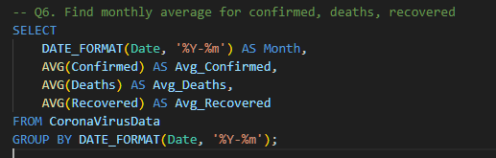
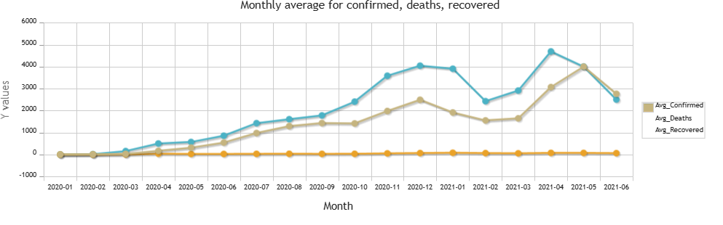
Q5. Find monthly average for confirmed, deaths, recovered

Slide 9
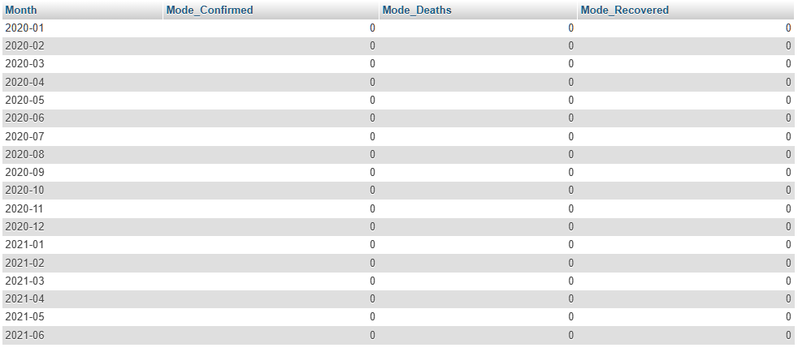
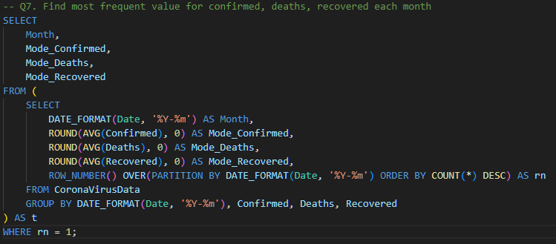
Q6. Find most frequent value for confirmed, deaths, recovered each month

Slide 10
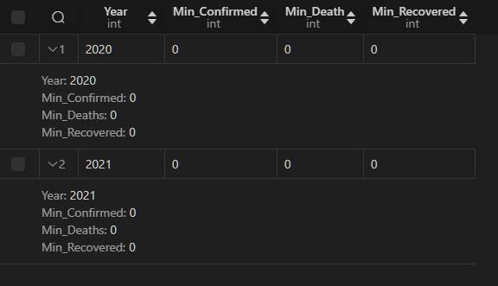
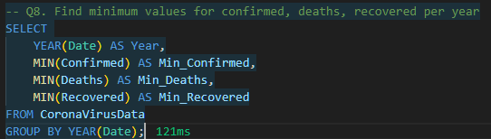
Q7. Find minimum values for confirmed, deaths, recovered per year

Slide 11
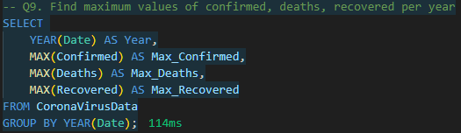

Q8. Find maximum values of confirmed, deaths, recovered per year

Slide 12
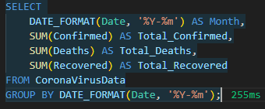
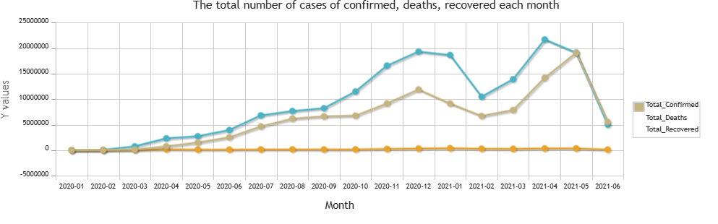
Q9. The total number of cases of confirmed, deaths, recovered each month

Slide 13
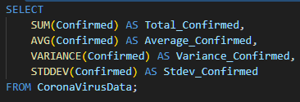
Q10. Check how corona virus spread out with respect to confirmed case

Slide 14
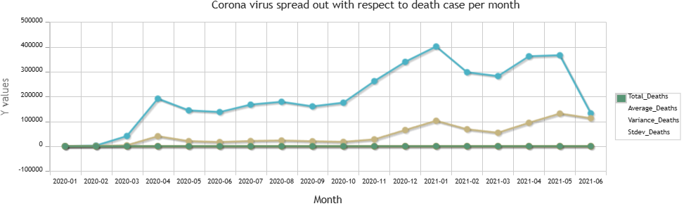
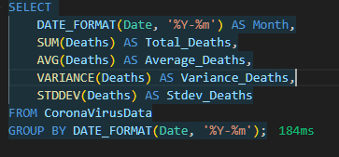
Q11. Check how corona virus spread out with respect to death case per month

Slide 15


Q12. Check how corona virus spread out with respect to recovered case

Slide 16
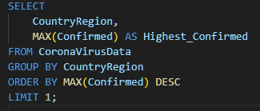

Q13. Find Country having highest number of the Confirmed case

Slide 17
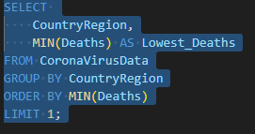

Q15. Find Country having lowest number of the death case

Slide 18
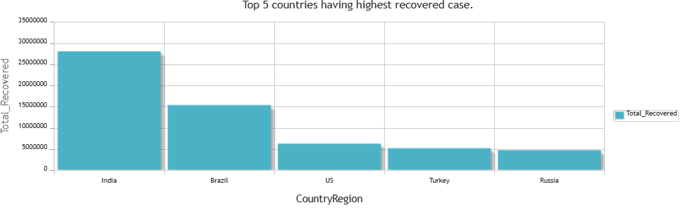
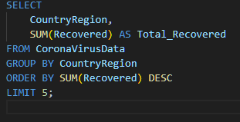
Q15. Find top 5 countries having highest recovered case

Slide 19
Final insights
Yearly Analysis (2020 and 2021):
In 2020, the maximum number of confirmed cases was 823,225, with 3,752 deaths and 1,123,456 recoveries.
In 2021, the maximum number of confirmed cases decreased to 414,188, with 7,374 deaths and 422,436 recoveries.
Overall Analysis:
The total number of confirmed cases from January 22, 2020, to June 13, 2021, was 169,065,144, with an average of approximately 2,157 cases per day.
The total number of recoveries during the same period was 113,089,548, with an average of approximately 1,443 recoveries per day.

Slide 20
Variability Analysis:
The variance and standard deviation of confirmed cases indicate a high level of variability in the number of cases over the analyzed period.
Similarly, the variance and standard deviation of recoveries also suggest variability in the number of recovered cases.
Country Analysis:
Turkey had the highest number of confirmed cases, reaching a maximum of 823,225.
On the other hand, Cyprus reported no confirmed cases during the analyzed period.
India, Brazil, the US, Turkey, and Russia are the top countries with the highest total number of recovered cases.
India leads with 28,089,649 recoveries, followed by Brazil, the US, Turkey, and Russia.
Overall, understanding these hidden insights provides a deeper understanding of the Corona Virus pandemic's dynamics, helping stakeholders make informed decisions to mitigate its impact and facilitate global recovery.

Slide 21
CONCLUSION
The data analysis of the Corona Virus dataset has offered critical insights into the pandemic's spread and impact, aiding in understanding its dynamics.
Through thorough examination of temporal trends, statistical analysis, and country-level comparisons, a comprehensive understanding of the pandemic's evolution has been achieved.
Future data analysis efforts could prioritize real-time monitoring, predictive modeling, and trend identification to inform proactive public health strategies.
Leveraging data-driven insights will enable better preparedness for future outbreaks, optimized resource allocation, and mitigation of the global impact of infectious diseases.
Overall, data analysis serves as a cornerstone in informing evidence-based decision-making and shaping effective responses to public health crises like the Corona Virus pandemic.

Slide 22

THANK YOU
NARAYANAN.M
Batch Name: MIP-DA-07
narayananmannazhi10@gmail.com

